Slide 1

Autonomous Scarecrow Robot
HND in Computer Science with AI
L M W K Lansakara – KIC-HNDCSAI-261-F-013
L G R Perera – KIC-HNDCSAI-261-F-043
Institute: NIBM
Date: 21/04/2026
Notes:
Good morning everyone. We are here to present our IoT and Robotics project, Autonomous Scarecrow Robot. I am Gavith Perera and my partner is Wethum Lansakara. This project was developed for the HND in Computer Science with Artificial Intelligence at NIBM.

Slide 2

Why it matters
Gardens face frequent damage from animals and intruders, while traditional scarecrows become ineffective over time. Continuous human monitoring is inefficient, so a mobile autonomous solution is needed to improve protection and reduce effort.
Notes:
In gardens and small farms, crops are often damaged by animals, birds, and even unauthorized human activity. Traditional scarecrows are static and become ineffective over time because animals get used to them.
So we identified the need for a smarter solution. Our idea was to create a mobile autonomous scarecrow robot that can patrol the area, monitor the surroundings, and respond automatically when movement is detected.

Slide 3

Project Overview
This project presents an autonomous mobile scarecrow robot designed to patrol garden paths, monitor the surroundings, and respond to potential threats. The robot follows a predefined path, performs environmental scanning, detects motion using sensors, and activates deterrents such as a buzzer and mechanical actuators. The system is designed to be low-cost, reliable, and suitable for small farms and home gardens.
Combines mobility and sensing for active protection
Automated responses reduce the need for manual monitoring
Modular design allows easy upgrades and future improvements
Notes:
This slide explains the overall idea of our system.
Our project is an autonomous mobile scarecrow robot designed to patrol garden paths and monitor the surroundings.
The robot follows a predefined path, stops at checkpoints, scans the environment, and detects motion using sensors.
When a threat is detected, it activates deterrents such as a buzzer and mechanical actuators.
The system is designed to be low-cost, reliable, and suitable for small farms and home gardens.
It combines mobility and sensing for active protection, reduces the need for manual monitoring, and supports future upgrades through its modular design.

Slide 4

Main Objectives
Automated Protection
Accurate & Reliable Detection
Ensure continuous autonomous patrolling to monitor all critical garden areas.
Integrate PIR and ultrasonic sensors with a servo-based scanning system for consistent and precise intruder detection.
Extended Area Coverage
Minimized Human Intervention
Utilize line-following navigation with predefined checkpoints to effectively cover multiple sections of the garden.
Automate alerts and response actions to significantly reduce the need for manual monitoring and control.
Notes:
The main objectives of our project were fourfold.
First, automated protection, so the robot can patrol continuously without depending on human supervision.
Second, accurate and reliable detection, by combining PIR sensing, ultrasonic confirmation, and scanning.
Third, extended area coverage, because the robot moves along a predefined path and checks multiple points in the garden.
And finally, minimized human intervention, since the robot performs monitoring and response actions automatically.

Slide 5
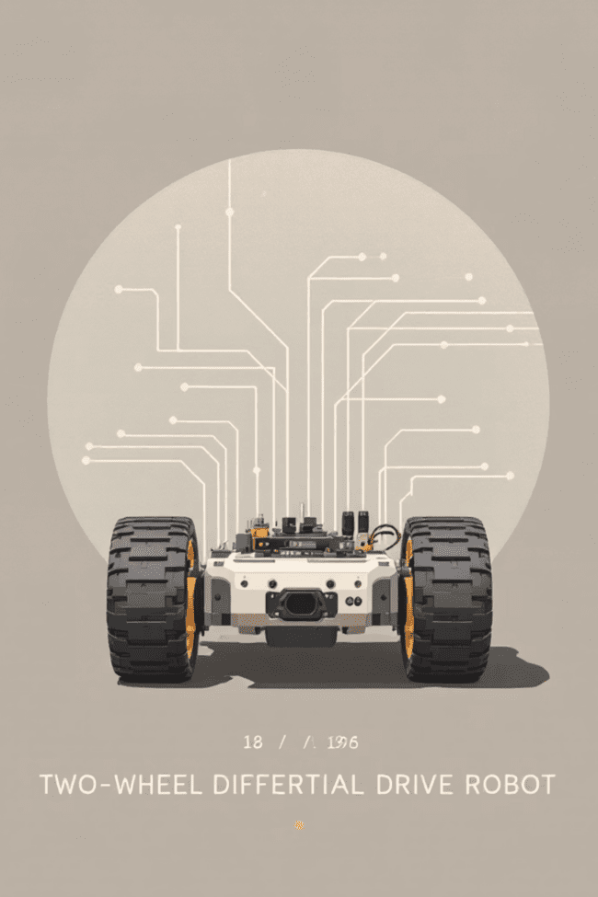
Main Functions
Line-following navigation to follow predefined paths and reach checkpoints
Stops at checkpoints to perform environmental scanning
270° scanning using a servo-mounted PIR sensor for wide area coverage
Motion detection using PIR sensor with distance verification via ultrasonic sensor
Alarm activation (buzzer) and actuator movement to deter intruders
Optional IoT alerts via ESP32 Dev Board for remote notifications
These functions work together to create a complete automated monitoring and deterrence system.
Notes:
Our robot performs several important functions.
It follows a predefined line path to move through the garden. At checkpoints, it stops and scans the surroundings. It performs approximately 270-degree scanning using a servo-mounted PIR sensor. When motion is detected, it validates the situation using sensors and then activates deterrents such as a buzzer and actuator movement. In addition, the system can support optional IoT alerts through the ESP32 Dev Board for remote notification.

Slide 6

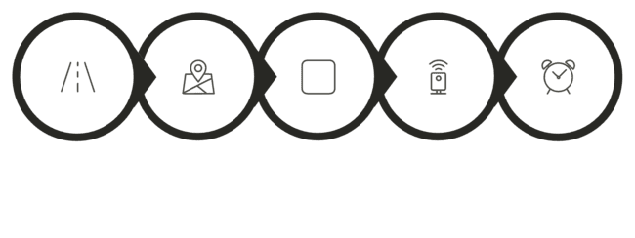
System Working — Core Logic
Reach Checkpoint
Scan (PIR on Servo)
Motion?
Alarm +
Actuator
Follow Line
Stop
The robot follows the path, stops at checkpoints, scans the environment, detects motion, trigger alarm and activate actuators, and then resumes movement. Motion confirmation uses PIR and ultrasonic sensors to reduce false detections.
Notes:
This slide shows how our robot works step by step in real-time operation.
First, the system starts and the robot begins following a predefined line path using line-following sensors.
When it reaches a checkpoint, the robot automatically stops to monitor that area.
At this point, a servo motor rotates the PIR sensor, allowing the robot to scan approximately 270 degrees around it.
During scanning, if motion is detected, the system confirms the presence using sensors and then activates the buzzer and actuator to scare away the intruder.
If no motion is detected, or after the threat is gone, the robot resumes patrolling and continues along the path to the next checkpoint.
This cycle repeats continuously, allowing the robot to monitor multiple areas in an automated and efficient way.

Slide 7
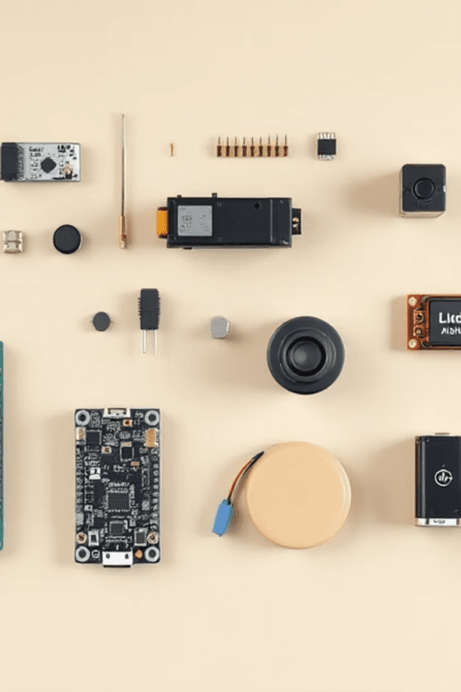
Bill of Materials (Key Components)
Arduino UNO — central controller
ESP32 Dev Board — IoT alerts and remote monitoring
L298N Motor Driver — controls DC motors and movement
DC Motors + Wheels — differential drive for mobility
Line-Following Sensor Array — path navigation
PIR Sensor — motion detection
Ultrasonic Sensor — distance validation to reduce false alarms
Servo Motor — rotates PIR for 270° scanning
Buzzer & Actuators — deterrent outputs
Battery Pack — portable power supply
All components are low-cost, widely available, and easy to maintain or replace.
Notes:
These are the main components used in our project.
We used an Arduino UNO as the central controller. An ESP32 Dev Board is used for IoT alerts and remote monitoring functions. An L298N motor driver controls the DC motors for movement. The robot uses DC motors and wheels for mobility. A line-following sensor array is used for path tracking. A PIR sensor is used for motion detection. An ultrasonic sensor is used for distance validation and obstacle-related awareness. A servo motor rotates the PIR sensor for scanning. Finally, a buzzer and actuators are used to scare away intruders, and the whole system is powered by a battery pack.
These components were selected because they are low-cost, available, and suitable for a working prototype.

Slide 8
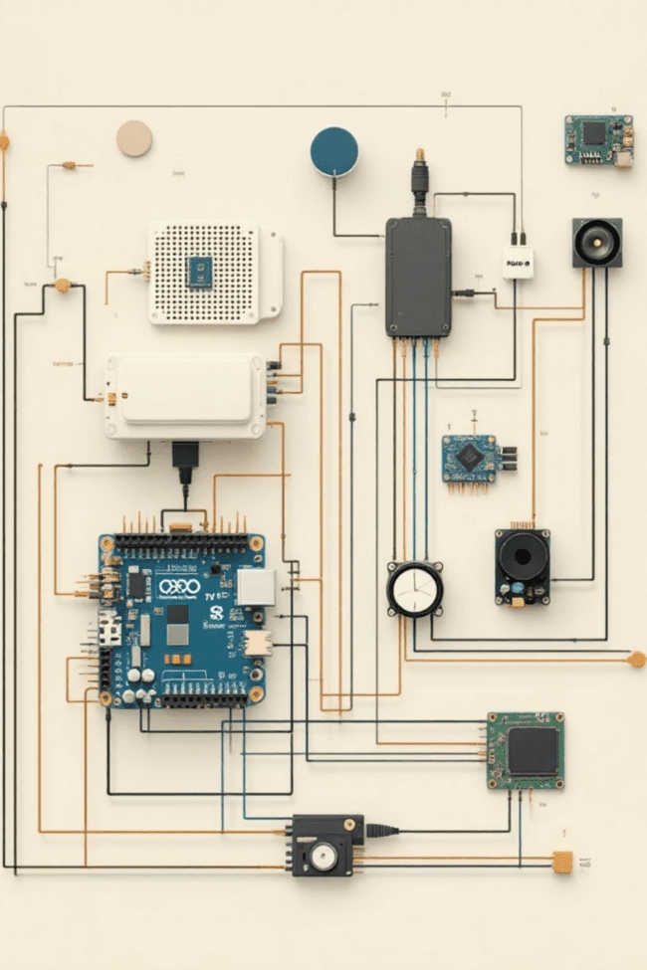
Electrical Architecture
The system uses a dual-controller architecture. The Arduino UNO handles the main control logic, including sensor processing, line-following navigation, and actuator control. The ESP32 supports IoT communication and additionally controls selected outputs such as a motor driver and buzzer for extended functionality. Separate power regulation is used for motors and logic circuits to ensure stable performance and reduce electrical noise.
Inputs
Processing
Line-following sensors
PIR motion sensor
Ultrasonic sensor
Arduino UNO — core logic and navigation control
ESP32 Dev Board — IoT communication and auxiliary control
Outputs
DC motors via L298N (Arduino-controlled navigation)
Additional motor driver (ESP32-controlled actuator system)
Servo motor (sensor scanning)
Buzzer (ESP32-controlled alert system)
Actuators for deterrence
Notes:
Our system uses a dual-controller architecture.
The Arduino UNO handles the core robot logic such as sensor reading, line following, navigation, and actuator control. The ESP32 Dev Board supports IoT communication and auxiliary output control such as alert-related functions.
For inputs, we use the line-following sensors, PIR motion sensor, and ultrasonic sensor. For outputs, we control DC motors, the servo motor, buzzer, and deterrent actuators.
This separation helps improve organization, stability, and future scalability of the system.

Slide 9


Flowchart Explanation
The system follows a structured control flow for real-time operation:
Motion Detected?
Yes: Activate Alarm | No: Resume Patrol
Start and follow the line until checkpoint
Stop and perform 270° scanning using a PIR sensor mounted on a servo
If motion is detected, activate the buzzer and actuator, and optionally send an IoT alert
After confirmation or timeout, the robot resumes patrolling
Stop & Scan
270° PIR scan
Move
Follow line to checkpoint
Start
System Initialization
Safety note: Adjust PIR sensitivity and include a manual override to prevent false or unnecessary alarms.
Notes:
This flowchart shows the real-time operational sequence of the robot.
The system begins with initialization. Then the robot follows the line until it reaches a checkpoint. At the checkpoint, it stops and performs a scan using the servo-mounted PIR sensor. If motion is detected, the buzzer and actuator are activated, and an IoT alert can also be sent. If no motion is detected, the robot resumes patrol.
This flow allows the robot to operate autonomously in a clear and repeatable way.

Slide 10

Conclusion & Next Steps
Summary
Scalability
An autonomous, low-cost robot that patrols, scans the environment, detects motion, and deters intruders—reducing crop damage and minimizing human monitoring.
The modular design allows easy integration of additional sensors and networking features, enabling expansion to larger farms and multi-robot coordination.
Immediate next steps
Conduct prototype testing in real garden environments
Fine-tune sensor thresholds and checkpoint timing
Integrate ESP32 Dev Board notifications and data logging
Ready for Live Demonstration & Questions
Notes:
In conclusion, our project delivers an autonomous, low-cost robotic scarecrow that can patrol, scan the environment, detect motion, and deter intruders. This helps reduce crop damage and minimize the need for continuous human monitoring.
For future improvements, we plan to:
test the prototype in real garden conditions,
fine-tune sensor thresholds and checkpoint timing,
and improve ESP32-based notifications and logging.
Overall, this project shows how robotics and IoT can be combined to create a practical smart agriculture solution.

Slide 11
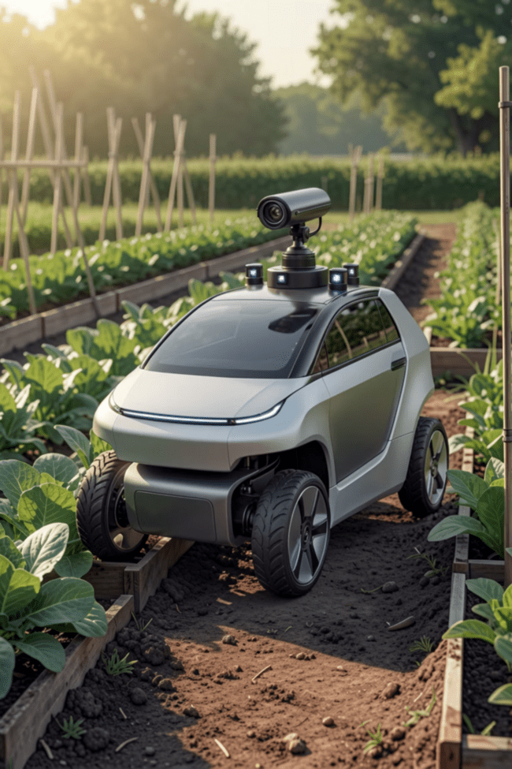
Live Demonstration
Witness the Autonomous Scarecrow Robot in action as we showcase its capabilities in real-time.
Path Navigation
Observe precise line-following across varied garden terrains and predefined checkpoints.
Motion Detection & Response
See how quickly the robot identifies potential intruders and activates deterrents.
Sensor Accuracy
Evaluate the reliability of PIR and ultrasonic sensors in real-time environmental scanning.
Live Monitoring
View real-time system status and updates through a web interface powered by the ESP32 Dev Board.
Notes:
“This robot follows a predefined path using its line-following sensors. When it reaches a checkpoint, it stops automatically. Then the servo rotates the PIR sensor to scan the surroundings. If motion is detected, the robot activates the buzzer and actuator mechanism to scare away the intruder. After the scan is completed or the threat is cleared, the robot resumes patrolling.”
During actual motion
Say short lines while demo is happening:
“At the moment, the robot is following the line.”
“Now it has reached a checkpoint and stopped.”
“Now the scanning process starts.”
“If movement is detected, the alarm and actuator will activate.”
“After that, the robot continues its patrol.”

